Slide 1
Processing Issues and Solutions:
RIEGL, LEICA and APPLANIX

Slide 2
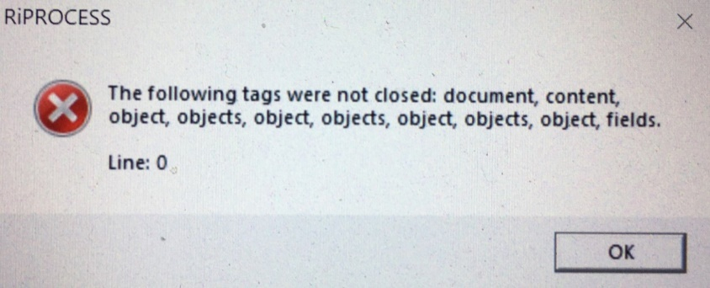
Riegl Issues :
This error occurs when the .rpp file is corrupted. Copy all files from 08_RECEIVED folder and replace all in main project folder. (.rhk, .rpc, .rpl, .rpp and .uid (if created). Resume processing.
Leap second error occurs when the leap second file is outdated. New file needs to come from Riegl and be placed in two separate locations:
From Riegl:
Please find attached the latest leap seconds file for RiProcess. Please copy the attached .list file to the RiProcess installation directory, and PLUGINS > Export directory from there as well as the main directory.
The default filepath is:
C:\Program Files (x86)\Riegl_LMS\RiPROCESS\PLUGINS\Export
C:\Program Files (x86)\Riegl_LMS\RiPROCESS respectively.

Slide 3
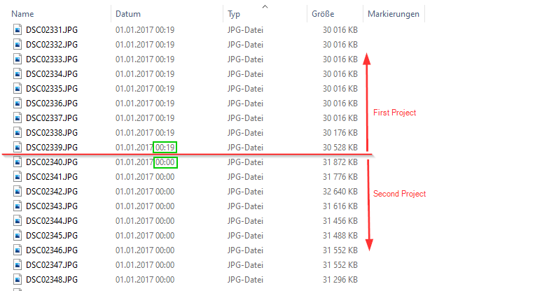
Point Cloud Colorizations
Open the 100MSDCF folder which contains all images for the entire survey. Separate the images into corresponding flights and copy to 04_CAM_RAW\03_IMG\CAMERA1 folder of the corresponding flight. Make sure to use all images. The number of images must match the image list from the .eif file. The software will sort out if images are required.
Make sure the Data Processing Wizard has been completed on both the Records001 AND Records001_cut These can be run in the same process.

Slide 4
ATMOSPHERIC CORRECTIONS ERROR
I had sent the error to Riegl and the response is below. So am not sure why, in our case, some projects have it and some do not. For instance the 22_287 flight that Anders is working on the file is present in the 06_ATMOS folder however the file is not present on the 22_292 flight at Kernen. So in future we check this folder and delete file if it is present.
**************************************************************
Hey Alistair,
This is likely due to the fact that you need to import your .ACL for under atmospheric conditions in the RiPROCESS project. If your system has an integrated atmospheric sensor, this would be stored under 03_RIEGL_RAW/06_ATMOS. You can check if any conditions were recorded here by opening the .ACL file in notepad.
If this time is empty, you can create a new .ACL in RiPROCESS by providing atmospheric conditions from that day, though be mindful of your units.
Let me know if you have any other questions.
**************************************************************
Hey again Alistair,
Just as a quick addendum, if this is for a ULS system, please remove the ACL file altogether.
******************************************************************

Slide 5
Cannot start task "RiUNITE 210818_173105_Scanner_1": No RiSERVER available for this task
This can mean two things:
means that the ri-server running on the local machine did not start properly – go to start menu and go to the riegl and start the riserver locally – try processing again
the License server software running on AUTHWIN may need a reboot/restart. This requires a ticket to IT to ask them to check license server software.

Slide 6
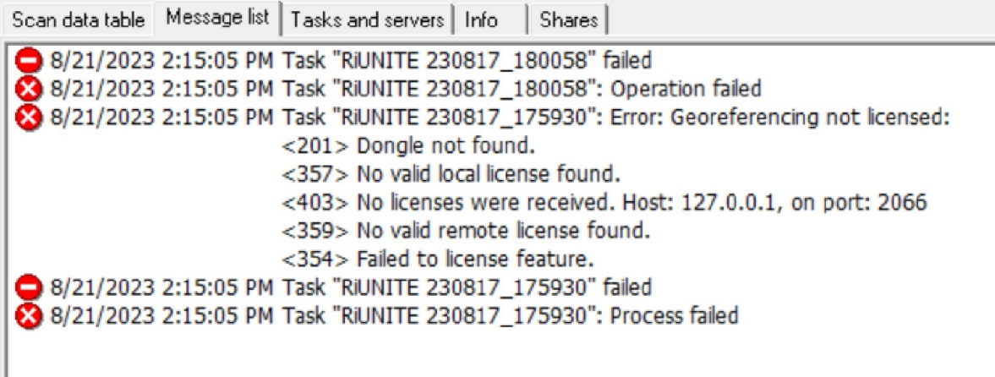
This issue below is caused by a miscommunication between the host computer and the Authwin server that runs Riegl License Server:
THINGS TO CHECK:
In RiProcess open the Tools/License Center go to “additional” tab AUTHWIN.usask.ca:2066 should be present in the window – right click this and select TEST. Test will fail if no connection. Right click again to select Report.
If it is not present ADD it in to the window and check project again.
Make sure RiServer is running on Host machine – double click icon in riegl folder in start menu or open the riserver management console. If you start the software check project again to see if error persists
Check that Ethernet cable is connected
Check if same issue occurs on other machines.
Restart the computer and check again. If still does not work then see step 7
Have IT restart the License Server software on Authwin – This requires a service ticket.

Slide 7
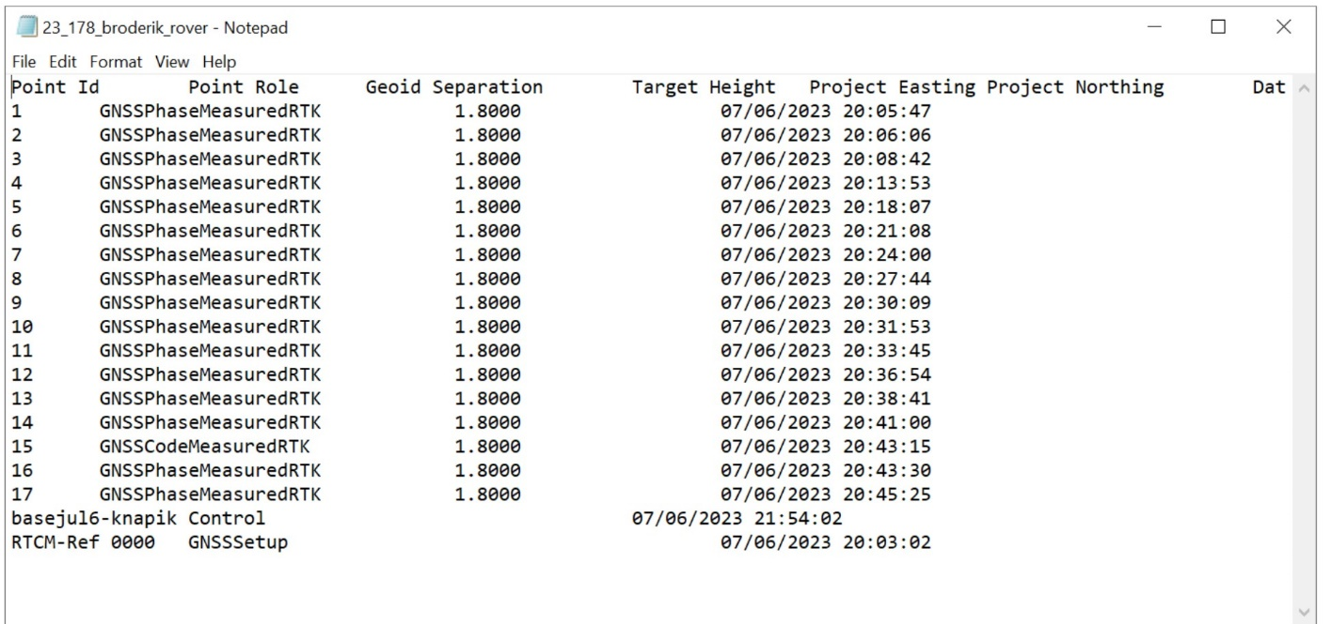
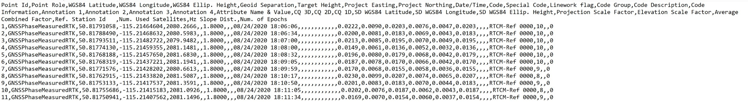
Leica Issues :
ROVER Issues
This issue (left) occurs in the output of the rover data (no coordinates) when the template has not been properly set in the software. Steps are outlined in the processing manual to prevent this issue. Below is correct.

Slide 9
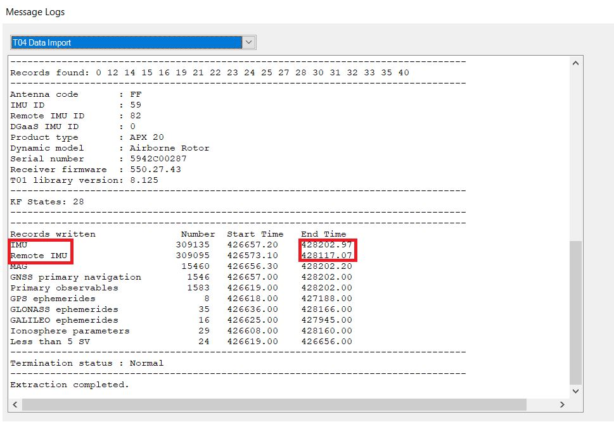
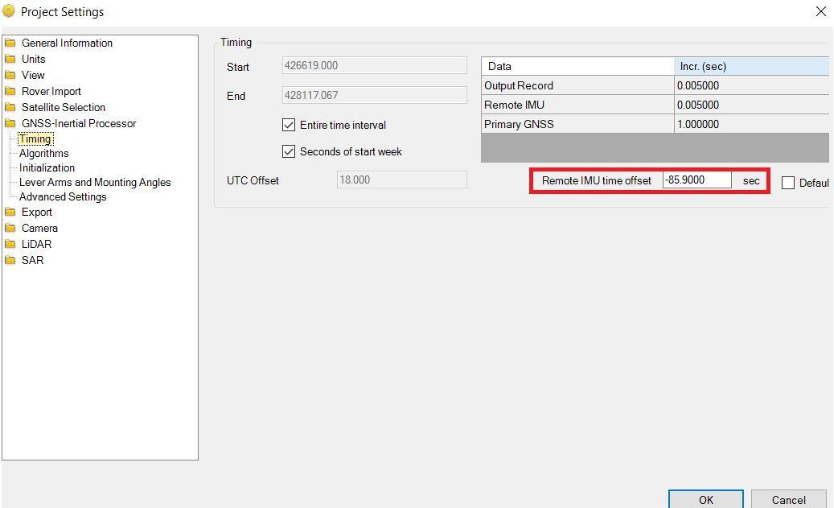
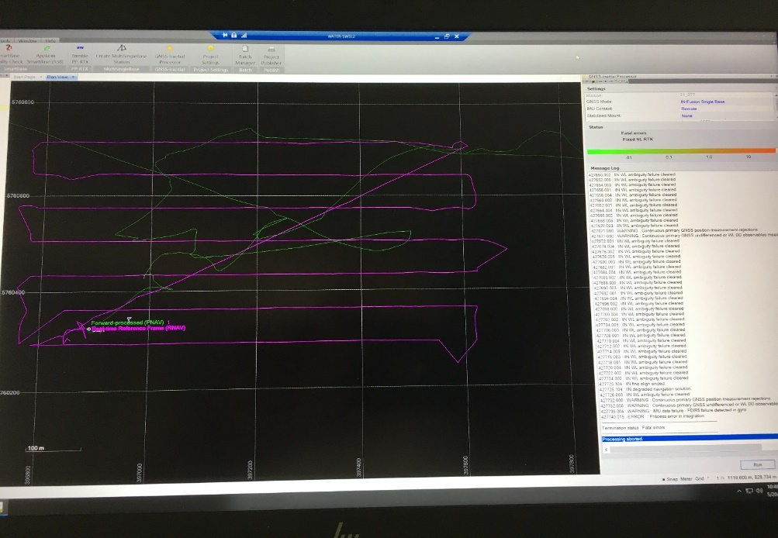
Applanix Issues :
POSPAC GNSS processing error
These messages(from gnss processing in PosPac) indicate gaps in the data causing a fatal error. This problem occurs when the remote IMU didn't synchronize properly in real-time with the GNSS data. Check timing in T04 Data Import log – if gap present make adjustment in the timing section of the Project Settings. go into your project settings then click GNSS-Inertial Processor settings and go into the Timing section then you should see a box in the bottom right that says "remote IMU time offset". This is where you need to enter -85.9 sec and then you should have no problems reprocessing this dataset.
From the log file :
WARNING : IMU data failure - FDIR5 failure detected in gyro
WARNING : Continuous primary GNSS position measurement rejections
WARNING : Continuous primary GNSS undifferenced or WL DD observables measurement rejections
WARNING : Gap in primary GNSS navigation data
WARNING : IMU data failure - FDIR5 failure detected in gyro
ERROR : Process error in integration
---------------------------------------------
Termination status : Fatal errors
---------------------------------------------
Processing aborted.

Slide 10
APPLANIX INTEGRATION ERROR
IINPP Forward-Backward Navigator [Feb 9 2023]
Copyright (c) 2008-2023 Applanix Corporation. All rights reserved.
Date : 04/03/23 Time : 11:57:31
--------------------------------------------------------------------------------
0.000 : Loaded 1 base station(s).
--------------------------------------------------------------------------------
Extracted data path : K:\23_083\23_083_a\230324_234124\pp3\harder3\harder3\Extract
Extracted data kernel : harder3
Processed data path : K:\23_083\23_083_a\230324_234124\pp3\harder3\harder3\Proc
Processed data kernel : harder3
Processing start time : 509856.000
Processing end time : 511003.000
--------------------------------------------------------------------------------
Selected GNSS mode : IN-Fusion Single Base - Short Baseline
Selected base station : basehardermar24
Selected subsystems : IMU
: Primary GNSS
: Base GNSS
Vehicle to reference alignment angles : 0.000 0.000 0.000
Realtime vehicle to reference alignment angles : 0.000 0.000 0.000
Multipath setting : LOW
Reference to IMU lever arm : 0.000 0.000 0.000
Reference to IMU alignment angles : 90.000 0.000 90.000
Reference to primary GNSS lever arm : -0.027 0.153 -0.185
Base GNSS coordinates : 51.983866053 -106.502607241 497.081
--------------------------------------------------------------------------------
Mask angle : 10.000
--------------------------------------------------------------------------------
<Continued to the right>
509856.003 : New or modified IIN install data
Reference-IMU lever arm: 0.00 0.00 0.00
Reference-primary GNSS lever arm: -0.03 0.15 -0.19
Multipath environment: LOW
509856.003 : Forward-time processing started
509856.098 : IIN coarse leveling started.
509859.095 : IIN coarse leveling ended.
509859.095 : IIN navigator initialized.
509859.095 : IIN degraded navigation solution.
509859.095 : IIN initial position valid.
509860.004 : IIN primary GNSS observables in use.
509860.004 : IIN in code DGNSS aided mode.
509860.104 : IIN navigator alignment active.
509860.000 : Reference to Primary GNSS lever arm calibration started.
509879.000 : IIN primary GNSS solution in use.
509879.000 : IIN in Fixed NL RTK mode.
510099.011 : ERROR : Process error in integration
--------------------------------------------------------------------------------
Termination status : Fatal errors
--------------------------------------------------------------------------------
Processing aborted.

Slide 11
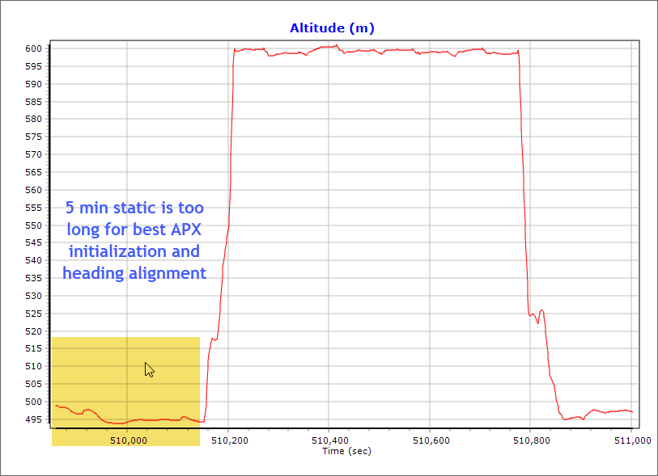
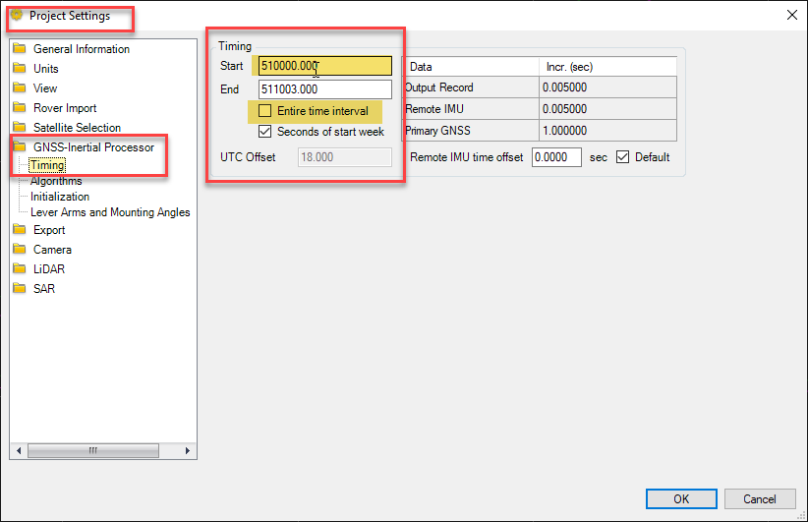
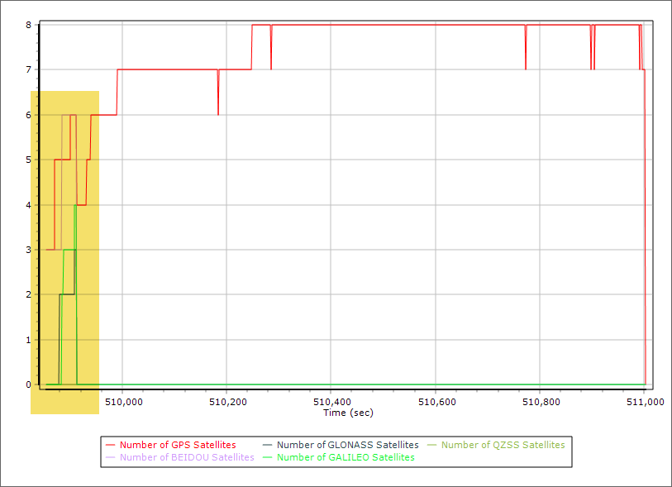
Hi Alistair,
Thank you for sending the data. I was able to replicate the error. The reason why the process that POSPac couldn't initialize properly; and that's because of the nature of the flight, where it was static for around 5 minutes before flying under a poor GNSS environment:
The workaround of this error is trimming the first 1-3 minutes of the static data, and the process should be successful. You can try the following timing:

Slide 12
APPLANIX INTEGRATION ERROR #2
IINPP Forward-Backward Navigator [Feb 9 2023]
Copyright (c) 2008-2023 Applanix Corporation. All rights reserved.
Date : 04/04/23 Time : 11:54:49
--------------------------------------------------------------------------------
0.000 : Loaded 1 base station(s).
--------------------------------------------------------------------------------
Extracted data path : K:\testerror_082\testerror\test_error\Extract
Extracted data kernel : test_error
Processed data path : K:\testerror_082\testerror\test_error\Proc
Processed data kernel : test_error
Processing start time : 423300.000
Processing end time : 425879.000
--------------------------------------------------------------------------------
Selected GNSS mode : IN-Fusion Single Base - Short Baseline
Selected base station : mar23-23
Selected subsystems : IMU
: Primary GNSS
: Base GNSS
Vehicle to reference alignment angles : 0.000 0.000 0.000
Realtime vehicle to reference alignment angles : 0.000 0.000 0.000
Multipath setting : LOW
Reference to IMU lever arm : 0.000 0.000 0.000
Reference to IMU alignment angles : 90.000 0.000 90.000
Reference to primary GNSS lever arm : -0.027 0.153 -0.185
Base GNSS coordinates : 51.521036117 -106.777304667 529.804
--------------------------------------------------------------------------------
Mask angle : 10.000
--------------------------------------------------------------------------------
<continued to the right>
423300.004 : New or modified IIN install data
Reference-IMU lever arm: 0.00 0.00 0.00
Reference-primary GNSS lever arm: -0.03 0.15 -0.19
Multipath environment: LOW
423300.004 : Forward-time processing started
423300.099 : IIN coarse leveling started.
423303.096 : IIN coarse leveling ended.
423303.096 : IIN navigator initialized.
423303.096 : IIN degraded navigation solution.
423303.096 : IIN initial position valid.
423304.000 : IIN in DR mode.
423304.100 : IIN navigator alignment active.
423304.000 : Reference to Primary GNSS lever arm calibration started.
423307.003 : IIN primary GNSS observables in use.
423307.003 : IIN in C/A GNSS aided mode.
423328.002 : WARNING : IINPP data failure - FDIR5 failure detected in RMS position error
423328.012 : ERROR : Process error in integration
--------------------------------------------------------------------------------
Termination status : Fatal errors
--------------------------------------------------------------------------------
Processing aborted.
FDIR5 – is an error in which the tolerances are exceeded for the variation of Gyro Bias, variation of Accelerometer Bias, and the variation of Gyro Scale Error. Look at the graphs and determin location and if at the beginning trim time. If in the middle maybe break into two trajectories.

Slide 13
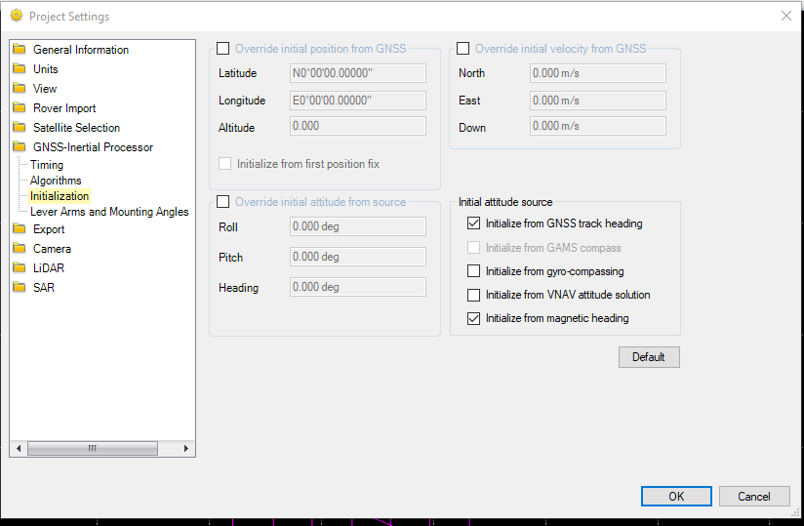
Applanix integration error #2 Continued
(https://help.trimblegeospatial.com/MobileMappingKB/PP-IMU-data-failure.htm)
IMU data failure – FDIR2 failure detected
Problem
During GNSS inertial processing, a fatal error occurs and this message is added to the log file:
IMU data failure – FDIR2 failure detected.
Solution
This issue can be caused by many different reasons. Please attempt the following:
If GAMS was used, verify GAMS lever-arms or turn GAMS off.
If DMI was used, disabled DMI.
Change initialization mode in GNSS-inertial processor to VNAV.
In some cases, this can be caused by gaps in POS data. This has been fixed in TMI version 3.2.4. Please update the TMI version in case you are under maintenance.
Related Products
Applanix POSPac
DEFAULT
Error typed into google – Trimble website provided this response.
Suggestion #3 was used and the trajectory was processed through with no issue

Slide 14
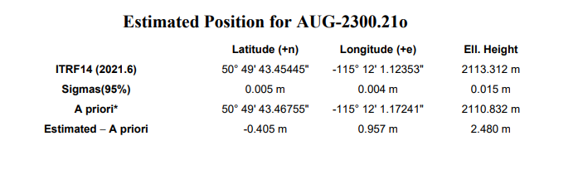
POSSIBLE Batch Issue with POSPAC
The issue is with PosPAC from what i can tell.
Attachment shows the coordinates difference between ITRF and A Priori is 2.48m
I reopened the batch program and it is saying that the base is set at the APriori coordinates : lat, long and Ell Height which would give the 2.48m difference but also will be positionally off.
But since I am sure I modified it because I would have to have missed all three not just ellipsoid height.
I ran a single project to create one trajectory, edited the base station coordinates to IRTF and it kept the IRTF settings – all looked good.
I then ran another batch file with three projects and set up and changed the base coordinates to ITRF and saved and processed.
It would appear from the project logs that the processing was completed with the APriori coordinates and not the IRTF coordinates. So whatever I typed in did not save for any of the three projects that were processed. This is the same thing that happened to the orig processing.
Not sure if this is a bug but it appears that I have a ton of re-processing and classification to redo ☹
Here is the question I don’t really want to ask – how many other projects have been processed with a Batch and are they off by similar amounts?

Slide 15
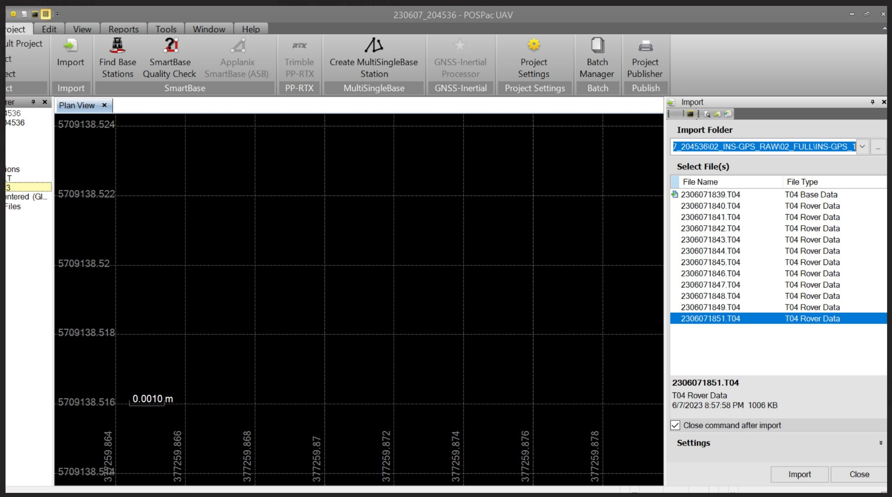
T04 files will not import into Pospac. Red box shows a missing T04 file. Skipped during the download of the data. This file still exists on the drone. Connect to the drone and enter the Applanix portal through the Riegl unit to retrieve the missing file.

Slide 16
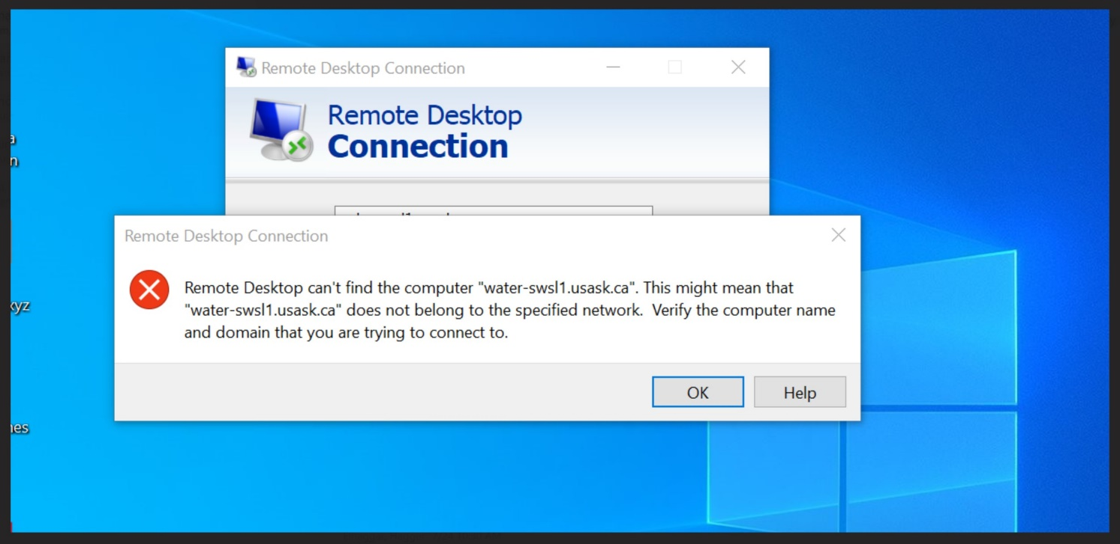
General Issues
This generally means that the host machine is off or needs a reboot. This needs to be done in the lab. This occurs when IT sends anupdate which requires a reboot.
RiWorld populates the Georeferencing component,
RiProcess goes to Kinematic LiDAR Data Processing, and RiPrecision licenses populate under Rigorous Data Adjustment ULS.

Slide 17
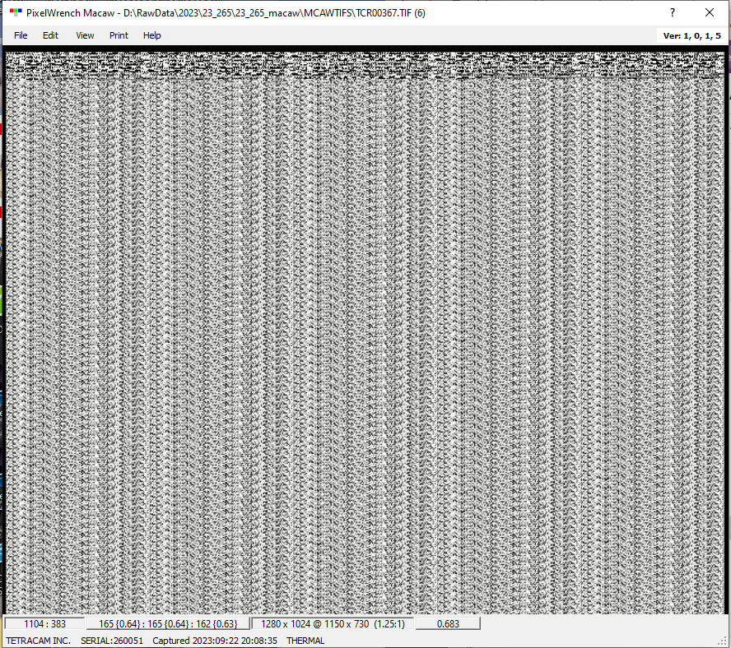
Pixel Wrench – Thermal band showing noise. Final answer TBD……

Slide 18
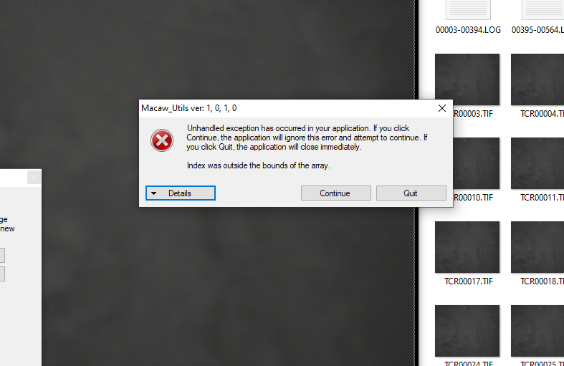
Pixel Wrench
ISSUE:
Funny update - Im now running into the exact same issue Nichole had with pixel wrench. I have tried a variety of different sources for my macaw images Im loading into the program (including raw images directly from the sensor), I have uninstalled and reinstalled pixel wrench, and I have restarted my computer and nothing is working. The program was working this morning for an hour or so, and then it just gave up mid-process. Any suggestions?
SOLUTION:
Figured it out! somehow there was no 'bandinfo.txt' file loaded into PW to begin with, so nothing was populated in the 'File Ops' screen and therefore the whole pixel wrench program was getting confused when trying to save data. I loaded in the basic 'bandinfo.txt' file on the File Ops screen and now everything is working
Other things to check:
Do you have any corrupt images? I have noticed that in the macaw images, there seem to be some that have a size of 0 and if those are left in the folder then pixel wrench has been pushing out that error

Slide 19
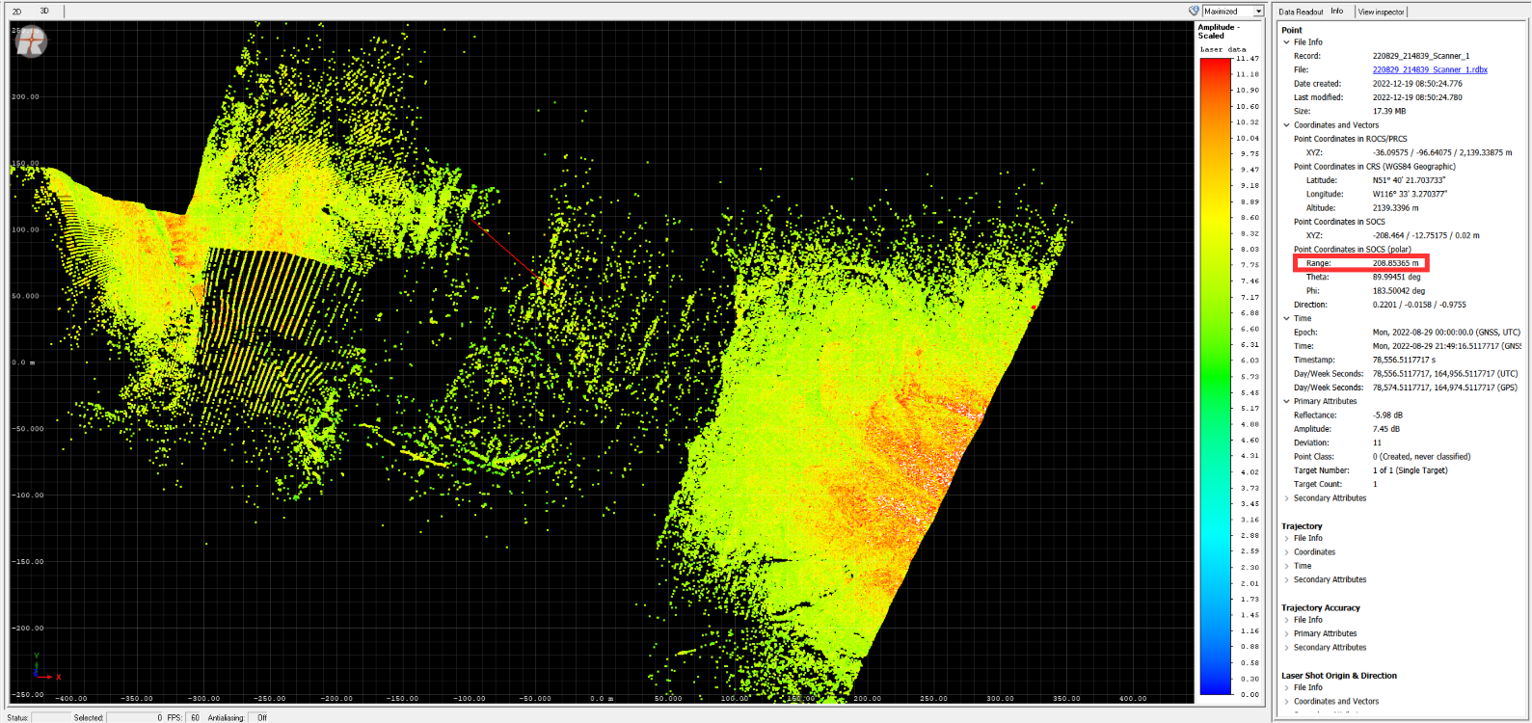
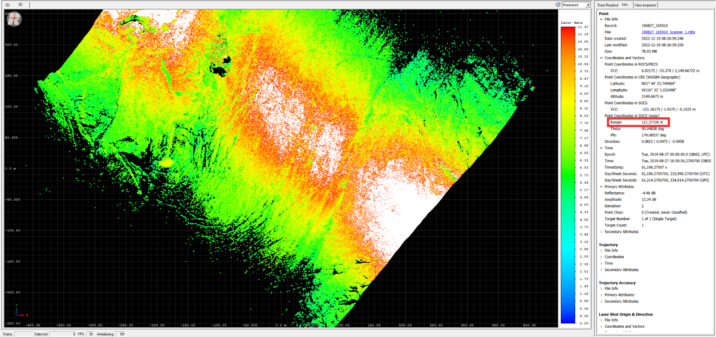
DROPOUTS
The issue that was discovered was a very large areas of no coverage/ missing points over the glacier. These “misses” of lidar points are dropouts. Meaning the laser power is not strong enough to hit the surface and return to the sensor and be recorded. The specification of the sensor is 120 m maximum +- 10m.
Riegl’s comments:
We have done additional analysis comparing the two flights, and a bit of a smoking gun has popped out as the reason for your data dropouts. The AGL of the miniVUX-2UAV collections flight seems to have been conducted at 200m, compared to 120m AGL on the miniVUX-1UAV. This is well outside of specification of the sensor, no matter the PRR.
Further analysis indicated that the dem used for the ALTAX was quite old giving a very different agl of the glacier surface. This difference plus the standard 120m flying height of the plan resulted in the unit flying too high and thus not being able to collect the required data.

